Slide 1














Avocado Budget:
Daniel Cronauer
Owen Hill
Abhik Ashwinkumar Patel
Devkumar Prakashbhai Patel

Slide 2
Why use Avocado Budget: If you just stopped buying avocado toast you could get a house or pay your student loans
Secure – runs local on your desktop or laptop
Local file system – no worries about your financial data moving over a network or needing an internet connection
Easy to manage expenses – enter, change, delete, view
Default template is provided based on your net monthly income if you desire that option.
Customize your budget across six predefined categories
Graphical representation of your progress against budget category by month
Easy to export your filtered results to excel for further review
Use on most devices – macOS, Windows, Linux – supports Safari, Chrome, Firefox, and Edge

Slide 3






What will we cover?
Owen will cover the database design and user story in regards to categories
Abhik will cover his implementation of the UI design according to user stories
Abhik and Devkumar to cover their testing. Then conclusion of the presentation.
Software Stack
DB design and Categories
CRUD
and Expenses
UI / UX
Front End
Test Plan
And Conclusion
We will cover the technology tools selected for this project
Daniel will cover the CRUD and user story in regards to expense implementation
Devkumar will cover the HTML and CSS that built the front end for the project

Slide 4
Tech Stack
Database = SQlite
CRUD = Python and Flask
Sqlite is free and open source
It is a local file based DB – allows embedding on local devices with no internet support
It has long term support
Worlds most widely used DB
Flask is a web framework that is minimalist in nature. Easy to prototype and handle get/post requests
Python is easy to write logic to handle CRUD
SQlite3 Library to interface with SQlite
Front End = HTML/CSS/JINJA
UI/UX
Jinja is a templating engine that can allow python to assist making dynamic html pages.
HTML/CSS to ensure data validation for forms, style the page and send proper GET/POST request routes to flask
Whimsical for User experience
Figma for user interface.

Slide 5
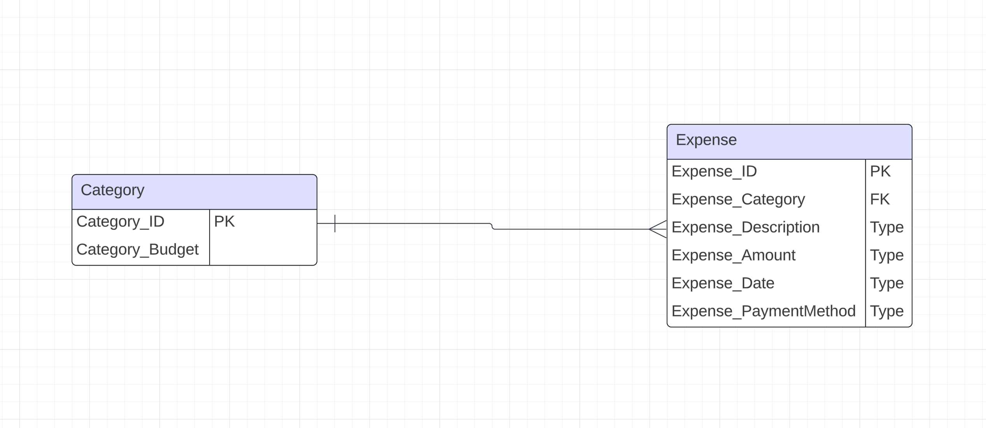
DB Design – Owen H
User Story: As a more experienced user I want to be able create a personalized monthly template since I know what I want my targets to be.
Requirement: The user shall be able to provide personalized numbers to their budget.
Design: This simple DB design will suffice for the entirety of the project. Each category will have a specified budget amount and each category will allow multiple expenses to be logged.
Conclusion: Category_Budget amount is able to be manipulated by the user to meet their desired needs (shown in next slide).
ERD:

Slide 6
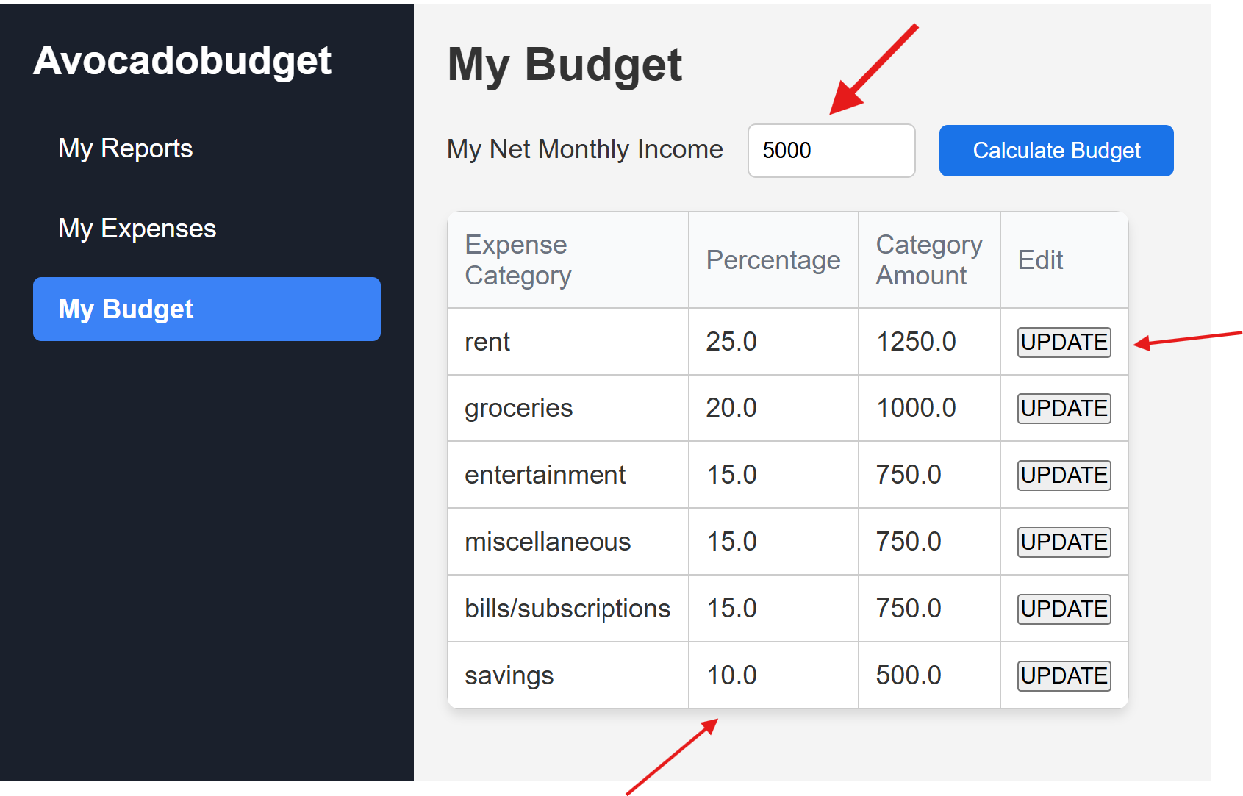
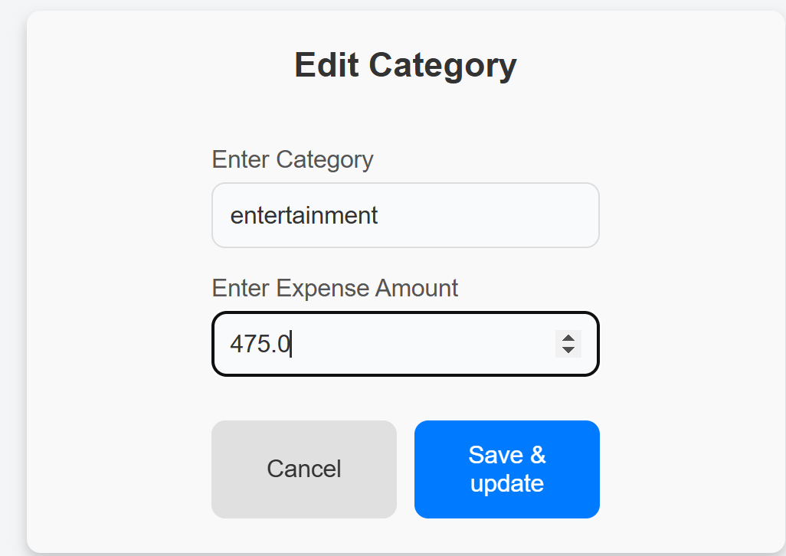
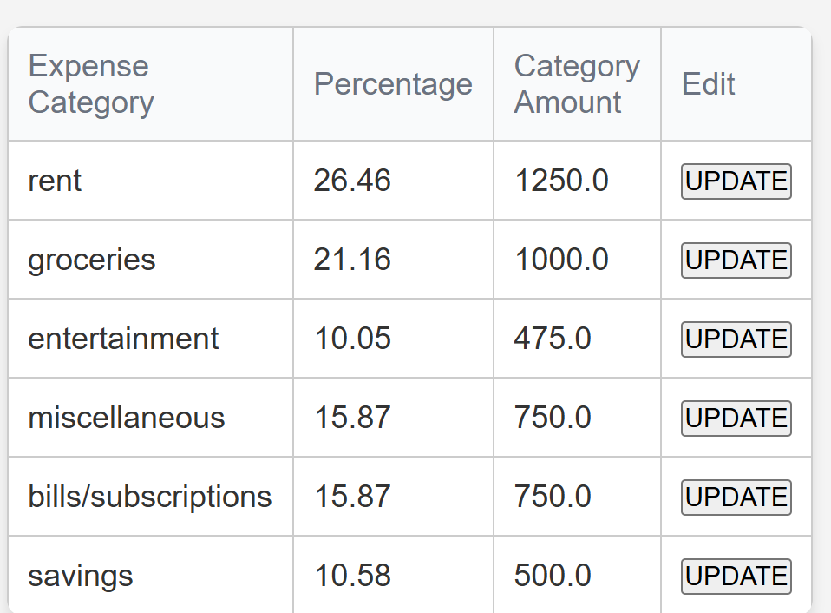
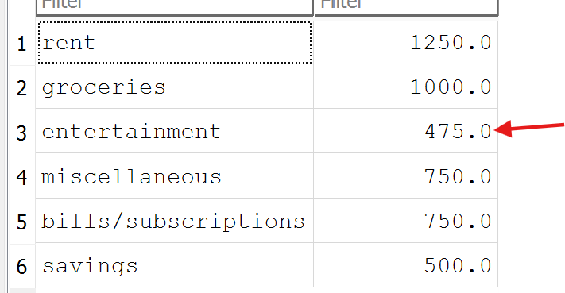
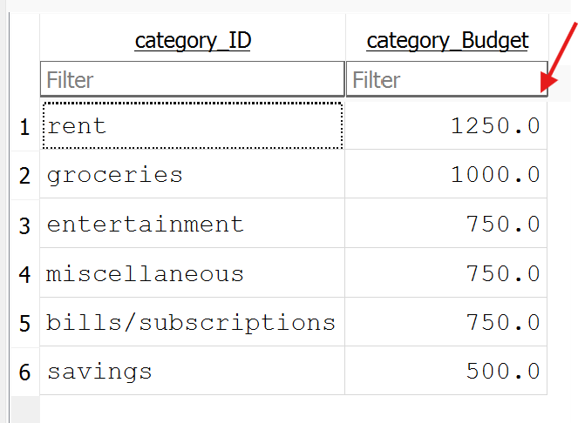
s
DB Design – Owen H
User Story: As a more experienced user I want to be able create a personalized monthly template since I know what I want my targets to be.
Requirement: The user shall be able to provide personalized numbers to their budget.
Specify income
Update amount
Generate Percentages
Before
After

Slide 7
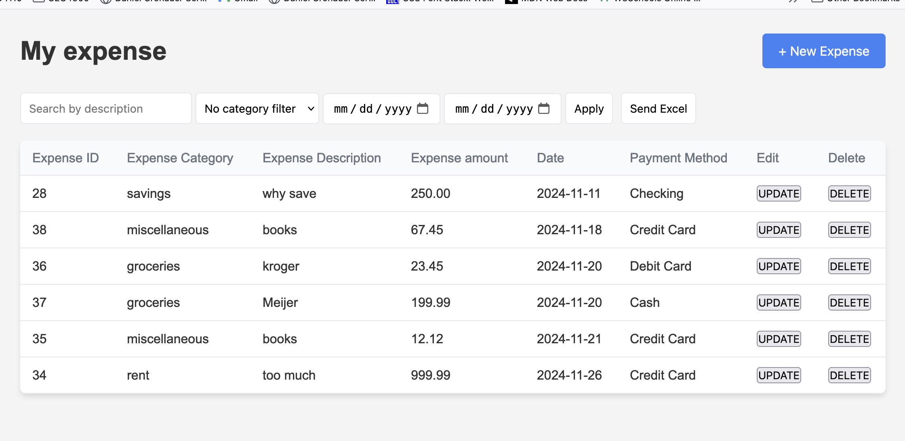
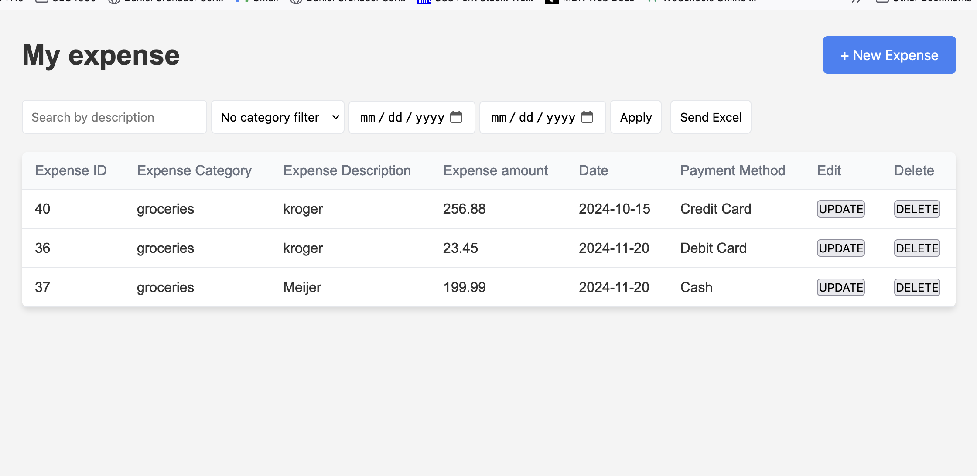
Crud – Dan C
User Story:
As an end user I want to track expenses in order to know how many avocados I can buy
Requirement:
The user shall be able to manage their expenses for retrieval and change
Design:
Expense Class :
class variables (expense id, expense category, expense description, expense amount, expense date, expense payment method)
dbOperations Class:
Handle all crud for whole database. Much of it revolves around expenses and categories.
Conclusion:
Expenses can be inserted, updated, deleted, read , filtered and sent to excel

Slide 8
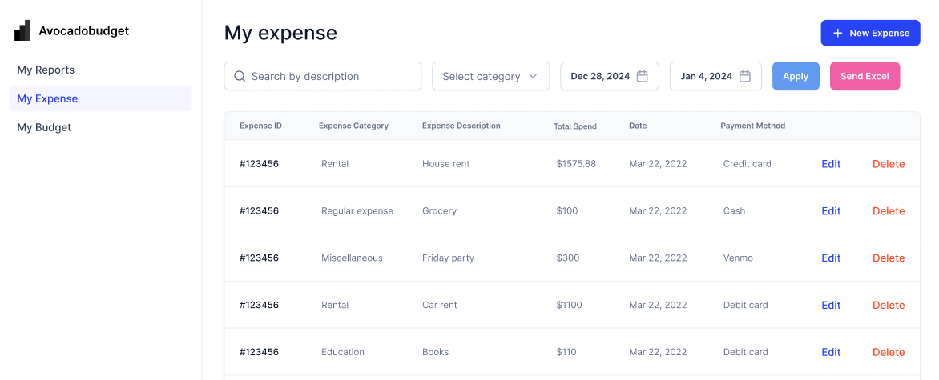
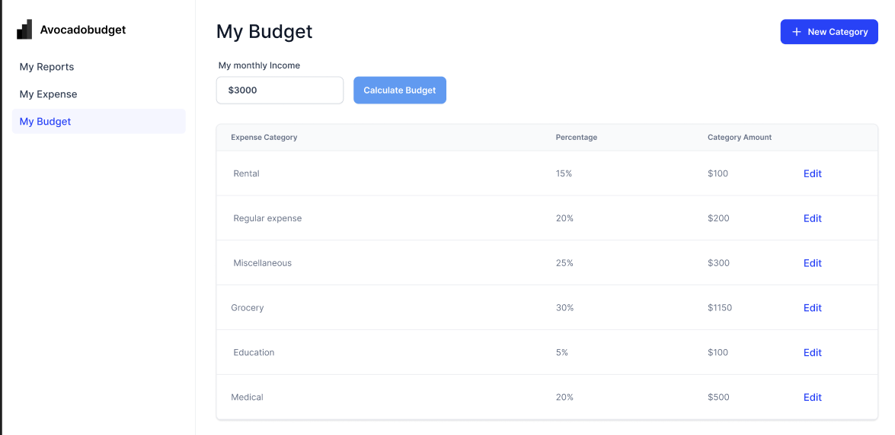
UI/UX – Abhik Patel
User Story:
I want to view a clear and intuitive interface for tracking my expenses such that I will understand just how much money is available for certain purchases.
Requirement:
The user shall have an intuitive and user-friendly way to view, edit, delete, and manage their expenses efficiently.
Design:
Users shall have a facility to mark a budget to each category and enter various expenses quickly so that tracking money cannot be so much of a trouble with the budget.
Conclusion:
A user would be able to conveniently modify the budget amount for each category according to their needs to bring about flexibility.

Slide 9
Front End – Devkumar
User Story:
As a user, I want to my expenses page, set up budgets page, and compare month-to-month financial performance through a clear visual report, using graphs and charts. I also want to be able to download financial data in Excel.
Requirement:
The user shall be able to manage their display visual reports, such as graphs and charts, to help users understand their current spending trends and user can able to download their report as excel file.
Design:
Expenses Page: Simple layout for entering expenses with fields (description, amount, category, date) and a table or list view for entries.
Budgets Page: Form with which one can set budgets and check progress through color-coded usage bars.
Report Page: Graphs (bar, line,) showing financial trends and a "Download as Excel" button on my-expense page.
Conclusion: The user will be able to view visual reports and download their expense data as an Excel file for better financial tracking and analysis.

Slide 10
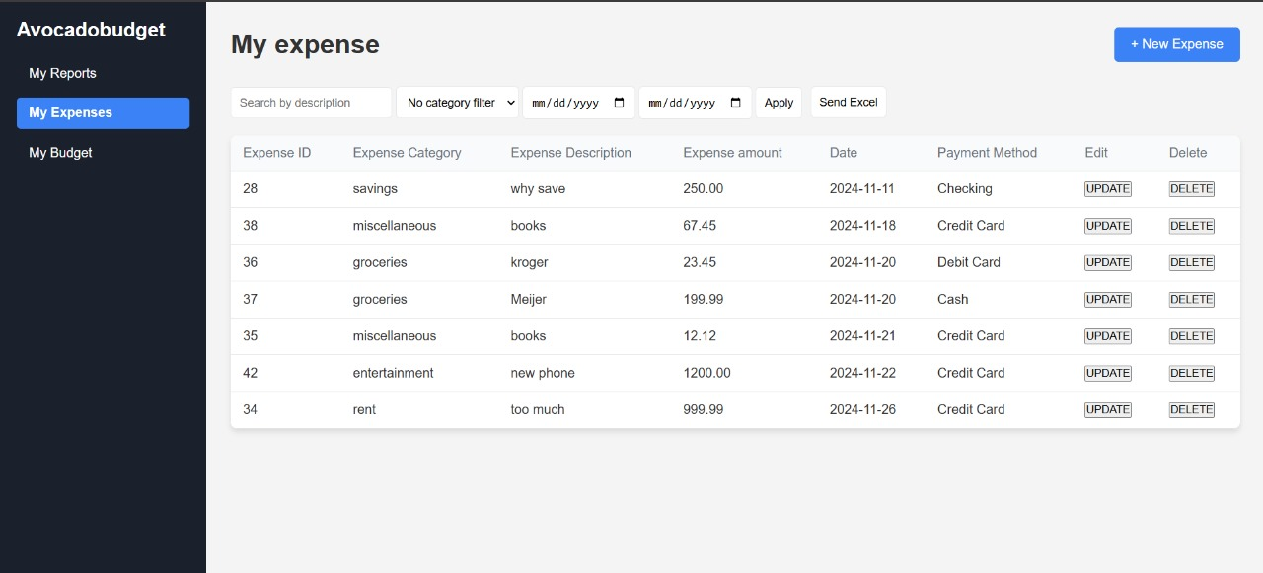
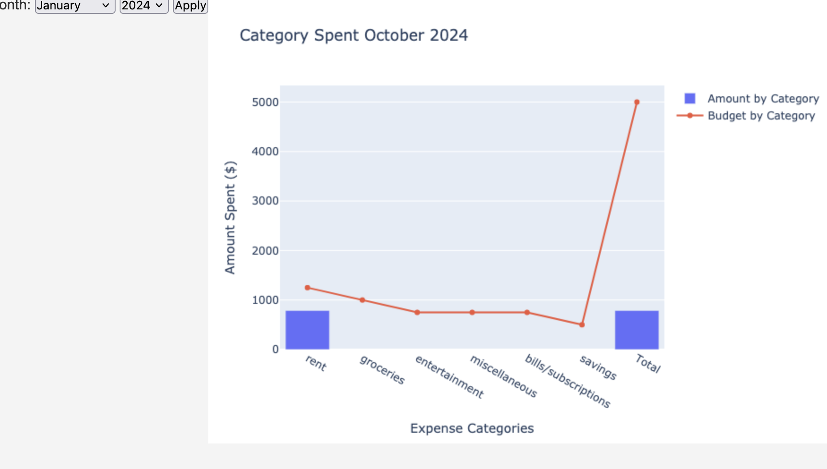
s
Front End – Devkumar
User Story: As a user, I want to my expenses page, set up budgets page, and compare month-to-month financial performance through a clear visual report, using graphs and charts. I also want to be able to download financial data in Excel.
User can download their report in format of excel
Line chart represent as Budget by Category
Bar chart represent as Amount by Category

Slide 11
Testing
Functional Testing
: Verify all major functionalities of expense management, budgeting templates, and reporting.
Usability Testing
: Ensuring the user interface is very easy to use and navigate.
Validation Testing
: This will ensure things like negative numbers, empty fields, and incorrect
data types are properly handled.
Bugs
Resolve
Expense Table
- Edit Functionality: Occasionally, the system failed to edit certain records.
- Delete Functionality: Clicking the delete button did not always remove the selected data.
Expense Table
- Edit Functionality: Enhanced logic to ensure consistent editing and deletion of records.
- Delete Functionality: Validated the functionality with thorough re-testing to confirm the issue was resolved.

Slide 12


Conclusion
This project helps users track and manage their personal expenses easily. They can set monthly spending goals for different categories to stay within budget. It gives a clear idea of how much to spend, helping users make better financial decisions. Overall, it’s a simple tool to plan and manage money effectively.

